Slide 1
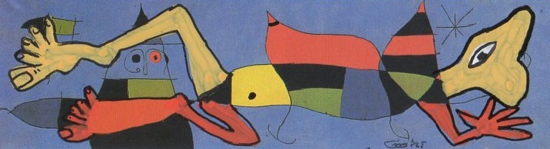
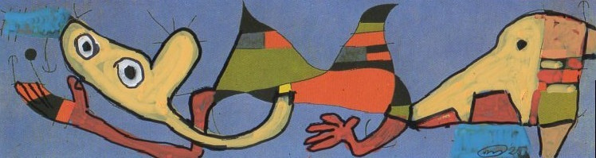
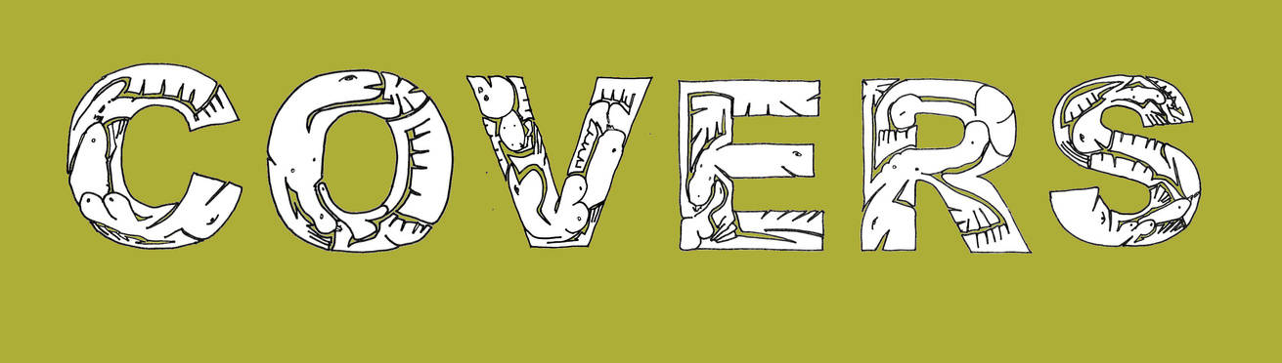
for the world

Slide 2
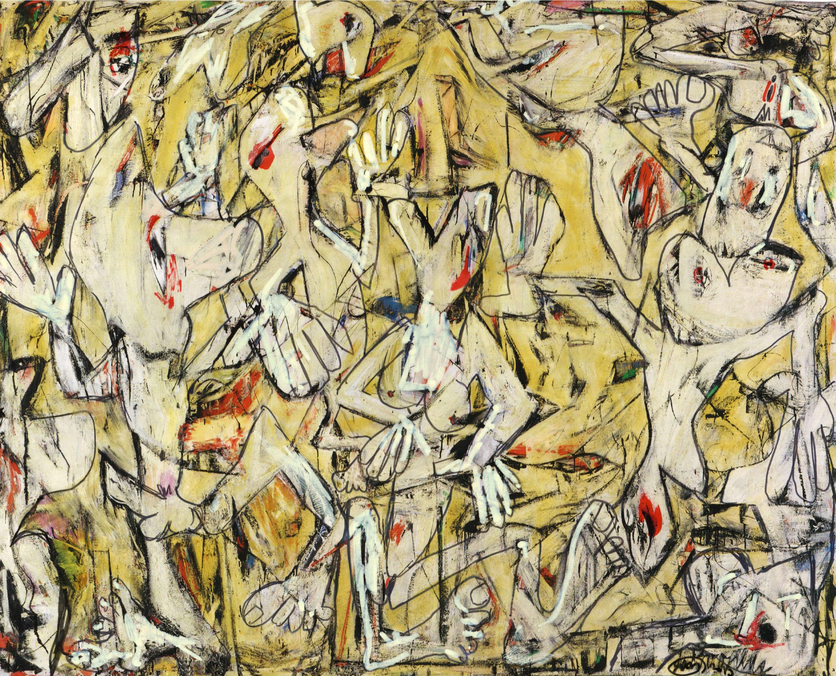
In a world that relentlessly exhausts itself, Covers by Pierre Mertens reflects the madness of the day — a daily gesture of attention to vulnerability.

Slide 3
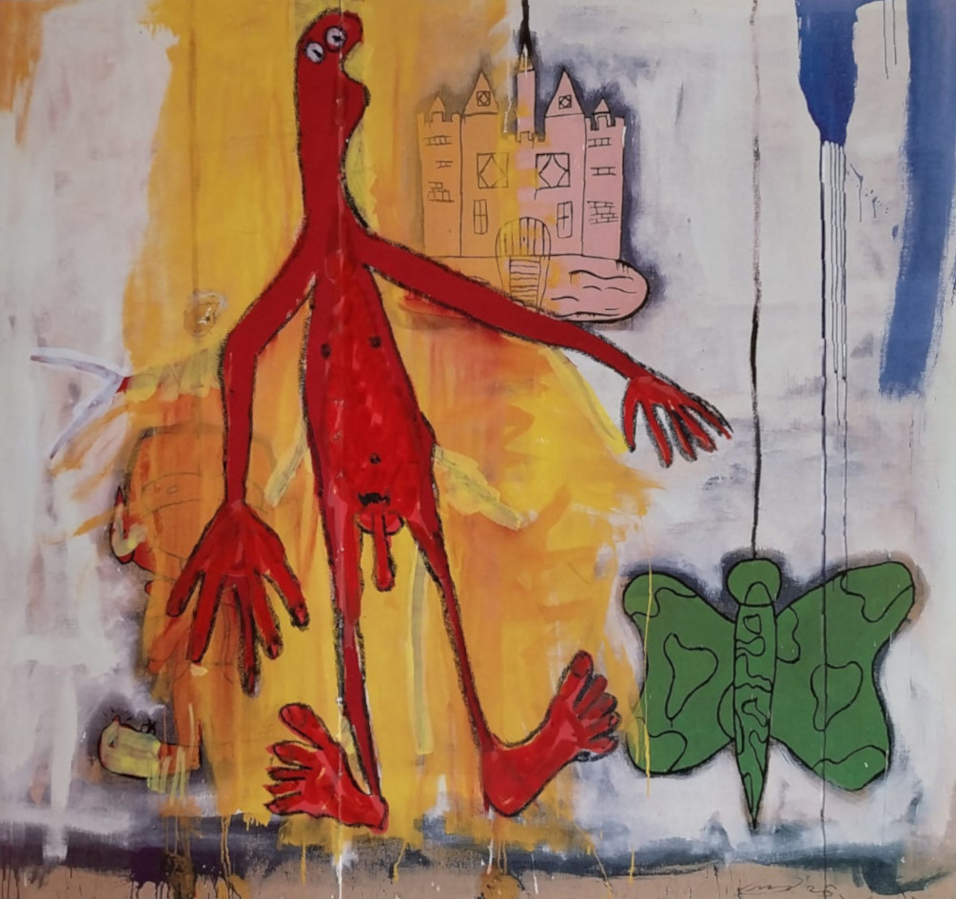
His work unfolds in the Anthropocene, an era in which humankind is no longer merely a resident of this planet but its main disruptor.
Mertens paints over existing images with his naked, human or dehumanized figures, bringing to the surface what we would rather ignore: vulnerability, rage, loss, exclusion.
Each drawing is self-contained yet part of a larger continuum—a visual timeline echoing the news of the day. Bitter at times, playful at others, but always rooted in commitment.

Slide 4
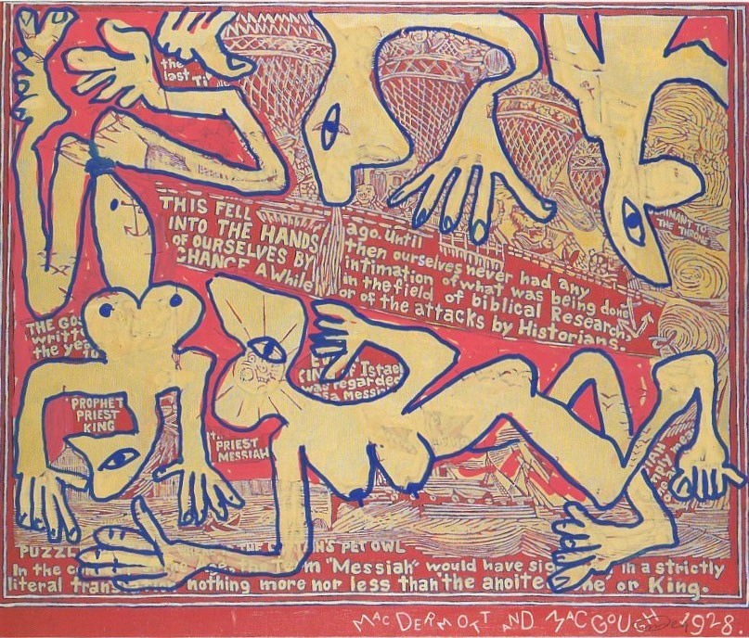
Since 2014, he has made one drawing every day, each on a reproduction of an existing artwork or on the cover of an art magazine. This has grown into an archive of more than 4,000 works.

Slide 5
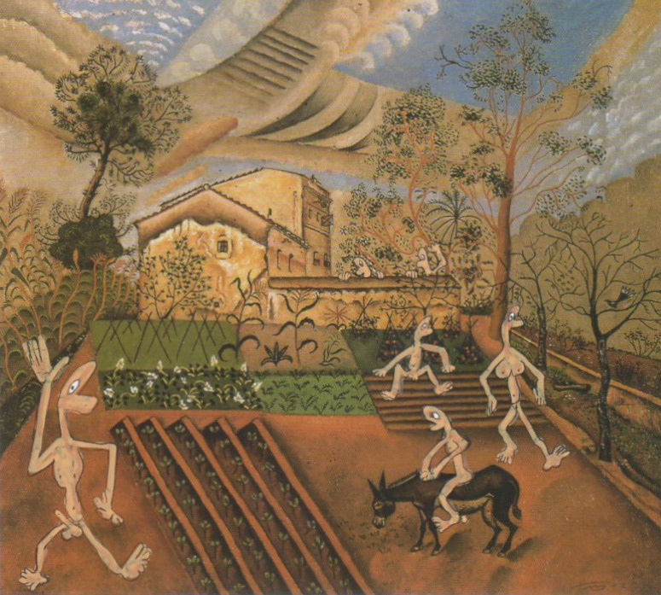
Each drawing shares its date with a news event
6/6/25: Judge blocks new Trump bid to deny US entry for Harvard’s foreign students

Slide 6
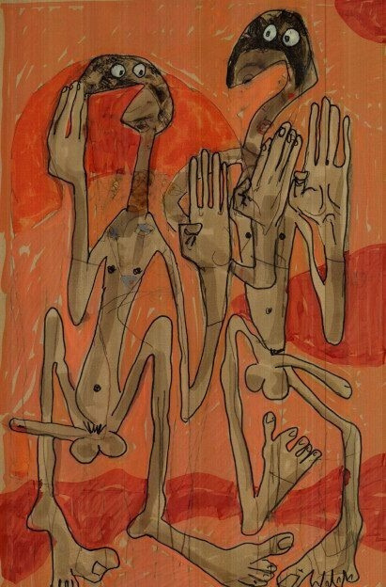
This body of work originated from the death of his daughter Liesje, born with spina bifida.
From the start, she was denied the care she had a right to, and she died at the age of eleven due to a medical error.
Since then, Mertens has refused to look away. Covers became his daily gesture toward change. What children like Liesje receive today in Europe — surgery, closeness, dignified care — he wishes for every child, including those for whom war, poverty, or exclusion make care impossible.

Slide 7
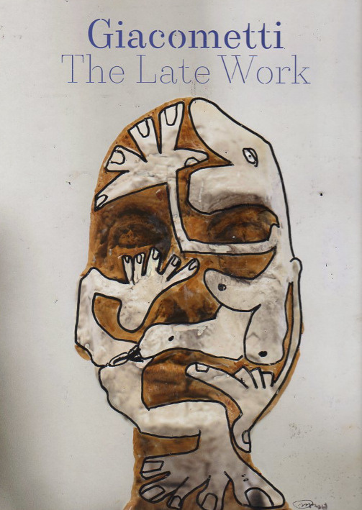
Art as Action,
as Commitment
Mertens now brings his Covers on the art market, dedicating his share of the proceeds entirely to Child-Help, the organization he founded in Liesje’s name.

Slide 8
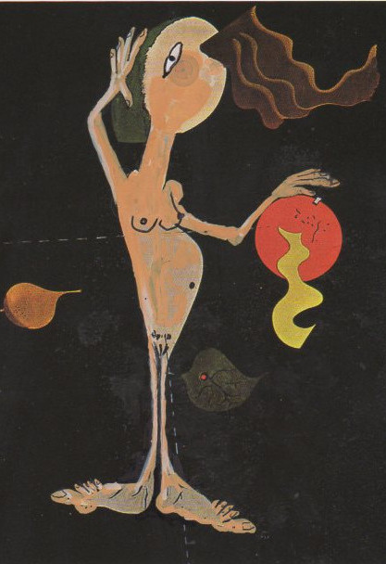
Launching Covers for the World
On December 3, 2025 – the International Day of Persons with Disabilities – Child-Help International, in collaboration with the Tanzanian self-help group in Moshi, will celebrate the opening of the sixteenth House of Hope and mark the launch of SHARE, the Global Knowledge Centre for Accessible Care.
To mark this moment, we launch Covers for the World. Pierre Mertens will collaborate with Tanzanian artists on a mural, create a collective reinterpretation of Picasso’s Les Demoiselles d’Avignon, present a thirteenth work from the Loving Care series, and organize a creative moment with children with spina bifida.

Slide 9
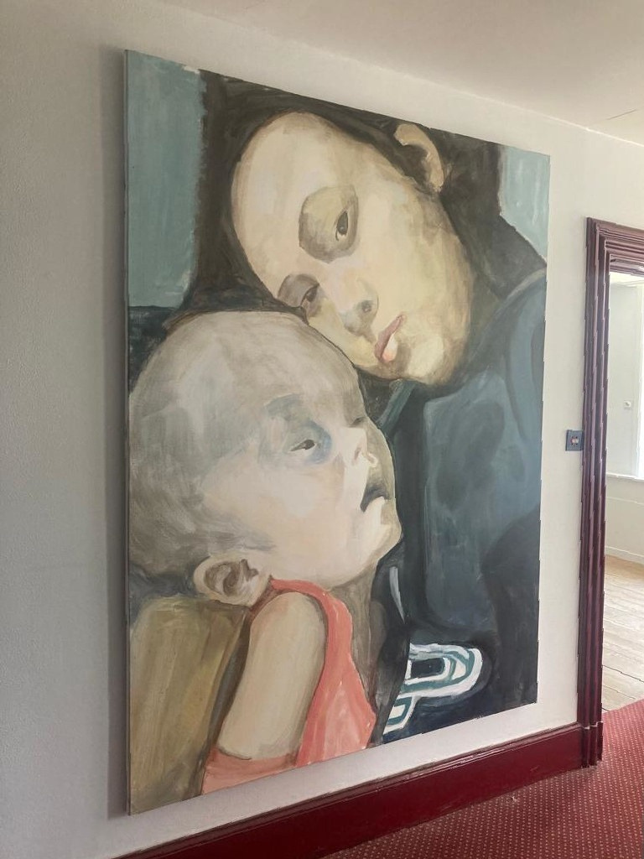
Loving Care
Pierre Mertens and Edith Doove have worked together since 2020 when they curated Loving Care: a series with portraits of children with untreated hydrocephalus. She re-presented the series at the Watou Arts Festival in 2023.
The series is based on photos posted by Filipino mothers on Facebook — intimate snapshots of their children with untreated hydrocephalus. While the enlarged heads are visually confronting,
Mertens approaches each portrait through the lens of motherly love. He translates these deeply personal images into large-format paintings (2m x 1.5m), turning the snapshots into silent testimonies of care and dignity.

Slide 10
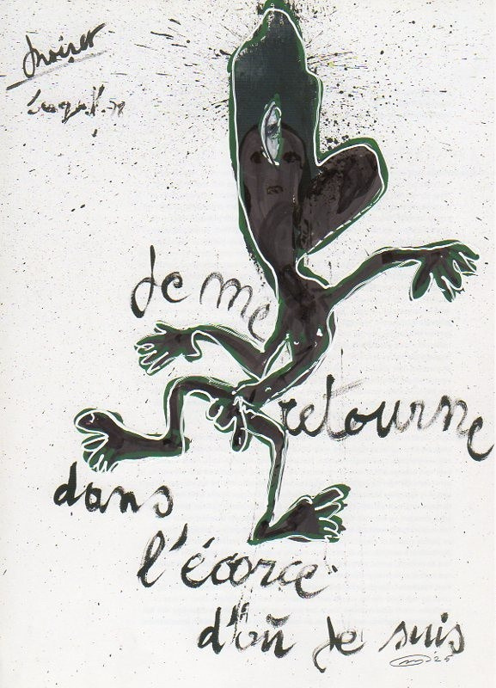
COVERS FOR THE WORLD
Exhibition opening on the occasion of the inauguration of the SHARE – Global Knowledge Centre for Accessible Care
Address: SHARE Knowledge Centre, Makongoro Street, Shanty Town, Moshi Town, Kilimanjaro, Tanzania
Wednesday, 3 December 2025 at 11:00am International Day of Persons with Disabilities
Participating Artists
Prince John Hugo · Lightness Jonas · Pierre Mertens · David Valerian Mlay · Lilian Munuo
Curator: Edith Doove

Slide 11
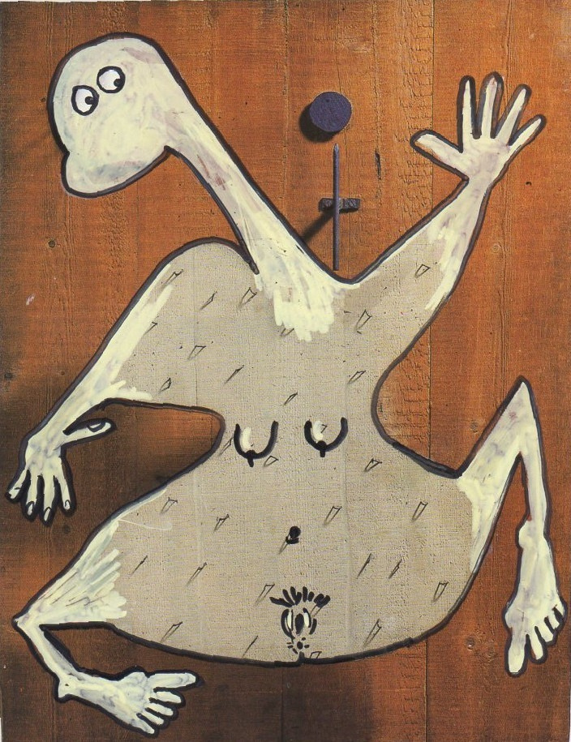
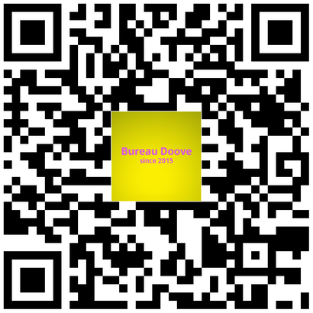
Will you join us?
Pierre Mertens and Bureau Doove are looking for partners worldwide to further develop the Covers for the World program. We invite museums or institutions that want to connect art and social engagement, as well as galleries and art journals interested in exploring the tension between image and activism, to collaborate.
Here, you can support this project.

Slide 12
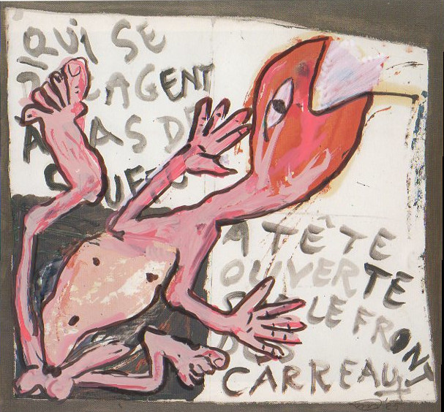
Covers creates space for reflection, discomfort, and connection. Each drawing is a call for care — for every child at risk of dying while waiting for treatment, or living in a place where care is reserved for the privileged.
Every sold work thus becomes part of a double story: one of artistic expression and one of concrete support for a vulnerable life.
Exhibitions can open powerful debates between art, time, decolonization, ethics, and social engagement. Those who share this vision are invited to contact Bureau Doove for possible collaboration.

Slide 13
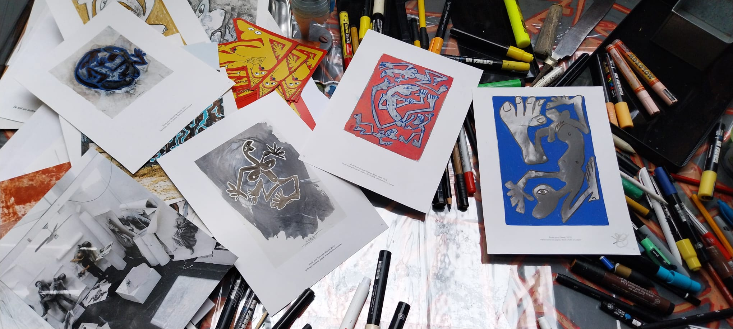
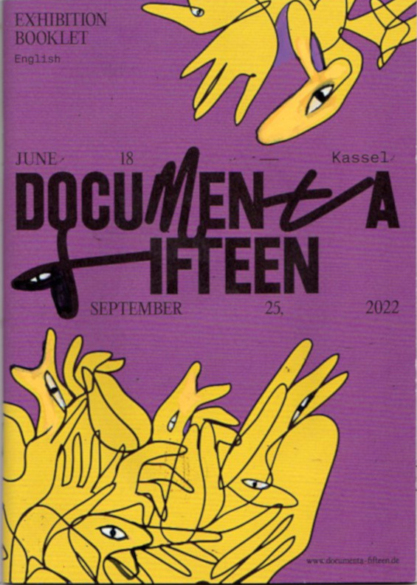

Slide 14
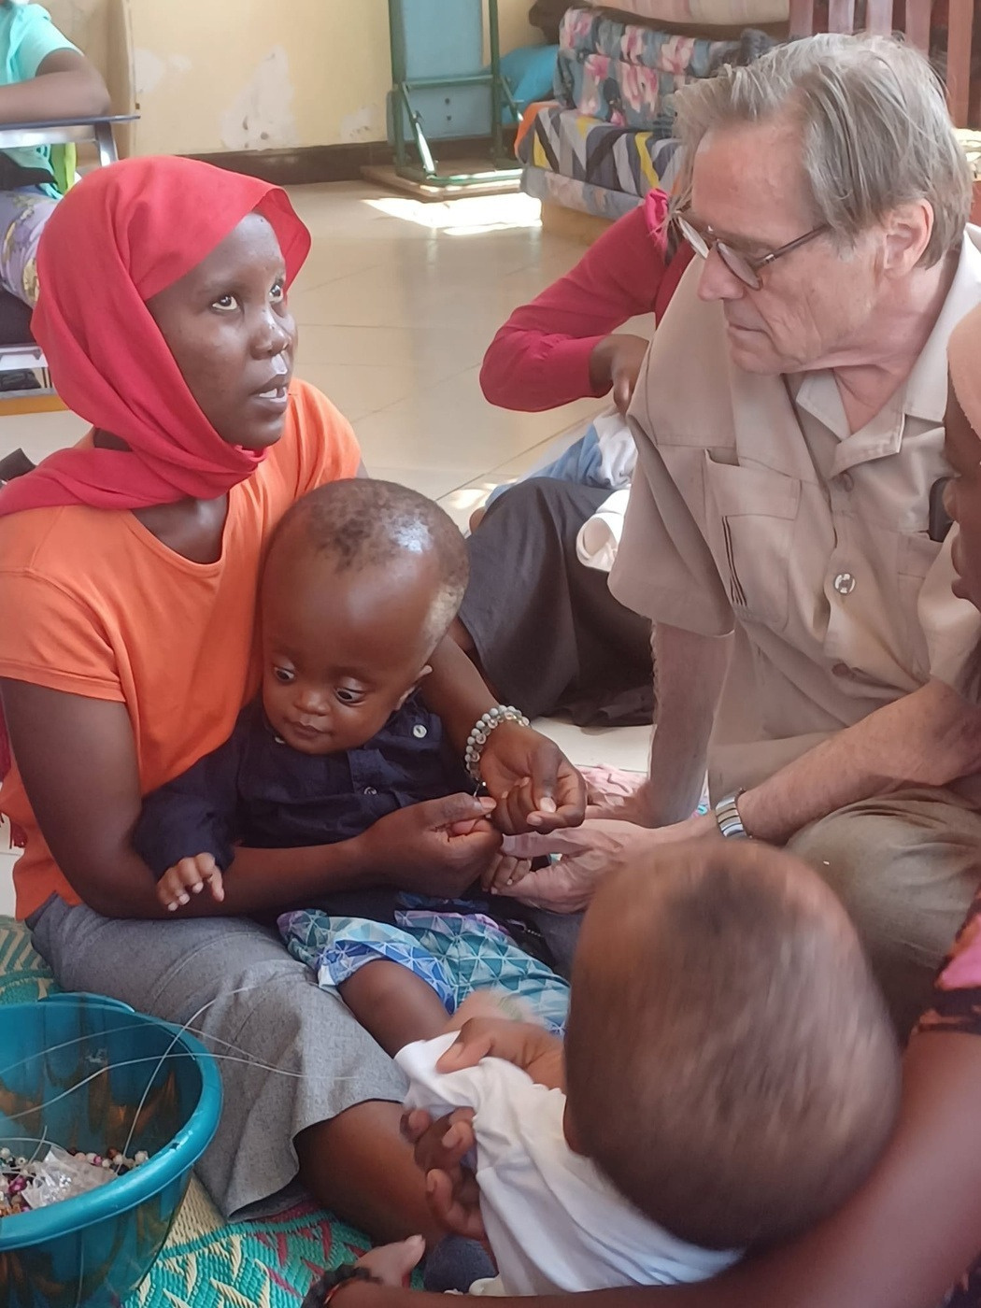

Every 30 seconds, a child is born with spina bifida and/or hydrocephalus. Survival begins with immediate treatment and accessible care. The Child-Help Knowledge Center translates global expertise into affordable solutions and supports national networks for change.
Child-Help was born out of the solidarity of parents of children with spina bifida worldwide. Because the organization works only with and from within the community in the Global South, it is an example of equal partnership.

Slide 15
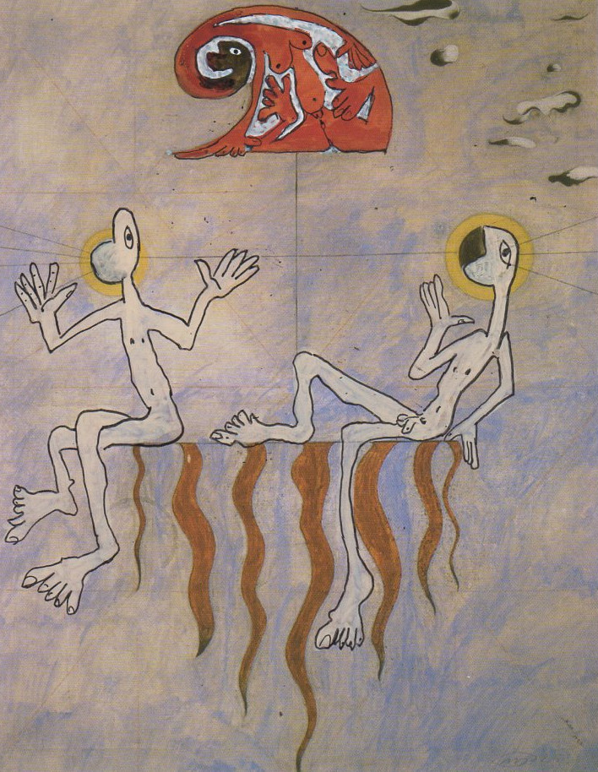
Covers
He wakes the dawn with trembling sight,
his brush a witness, day and night.
Each line repeats what time betrays
the painter of forty thousand days.
He paints the world that cannot sleep,
the cries the headlines cannot keep.
He overlays the saints, the kings,
their vanished faces, feathered wings.
Picasso murmurs, ‘Break to see.’
He tears the truth from history.
Guernica bleeds through Gaza’s glare,
old sorrow sighs in modern air.
The colours clash, the stories rhyme,
tomorrow spills from yesterday’s crime.
Each stroke a prayer, each hue a scar,
each newsflash flickers where the dead things are.
He paints not beauty, but its ghost,
the ache that art remembers most.
He paints, erases, paints again
to dream the grief that won’t remain.
Mark Kinet

Slide 16
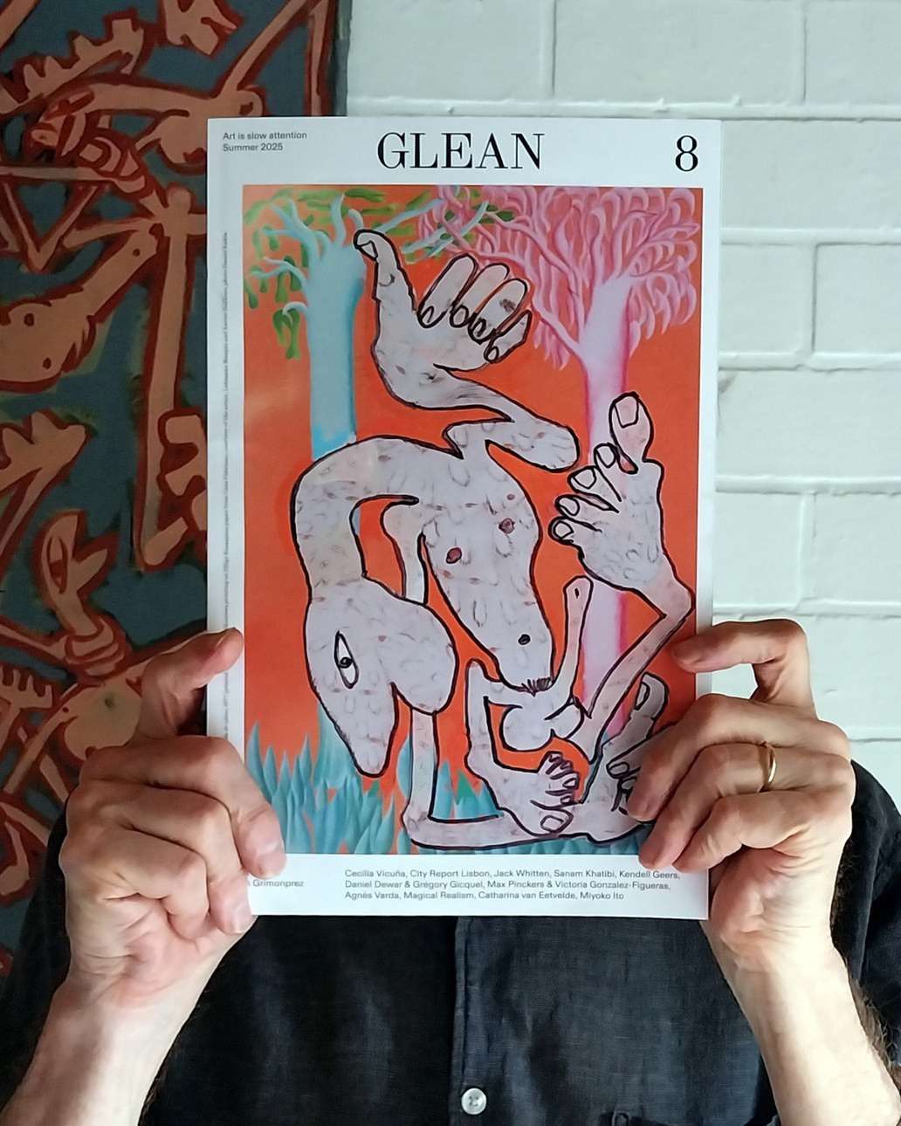
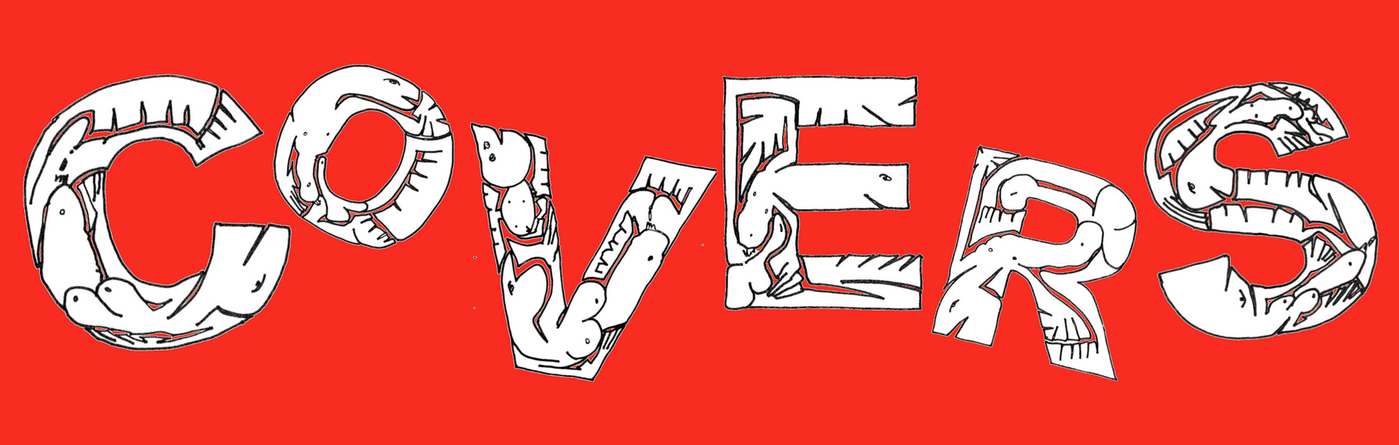
Pierre Mertens
info@pierremertens.be
www.pierremertens.be
+32(0)498504859
Edith Doove
contact@bureaudoove.com
https://bureaudoove.com/
+33(0)772079708

